Slide 1

Proposed PIT Tag Antenna Arrays for
Bonneville Dam PH1 Ice and Trash Sluice Way
PTAGIS Field Office
Kennewick, Washington
June 2015

Slide 2
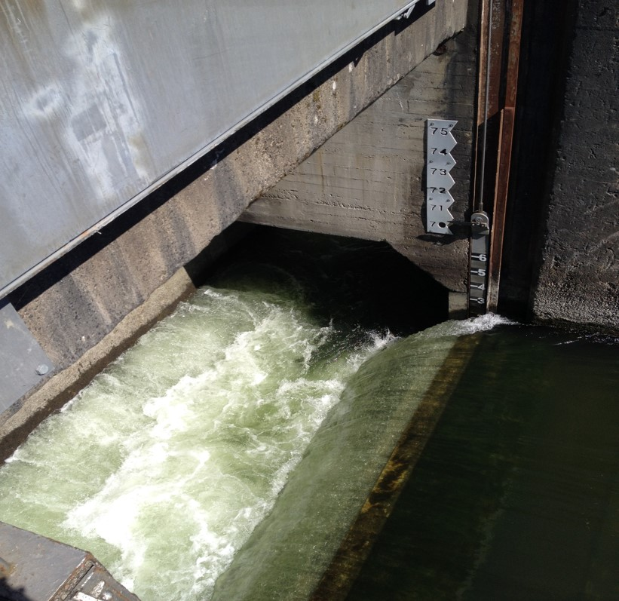
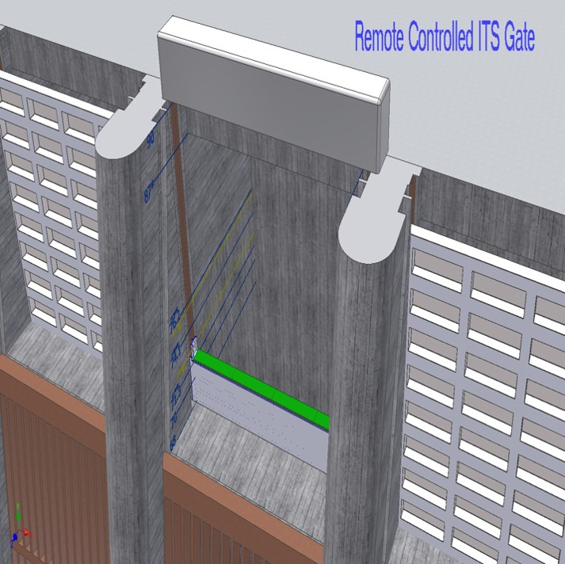
Control Bay’s Quad Flat Plate Antenna Array
Quad Antenna
Target Location
Control Weirs 3B, 6C and 10B.
Quad Antenna Arrays.
Notes:
.

Slide 3
Control Bay’s Quad Flat Plate Antenna Array
Flat plate antennas consist of 4 individual antennas using the proven ferrite tile, thin body design.
The 4 antennas are positioned “End to End” across the top of the control gate(s). Each of the 4 antennas would have a unique identifier that will reduce tag collisions across the gate.
Each antenna will be powered using the Biomark Inc. IS-1001 transceiver. Four transceivers per bay will be required.
This configuration does not provide any detection redundancy.
Redundancy could be implemented by the addition of a “Pass Through” antenna located on the trash rack as shown in next slide.
Notes:
.

Slide 4
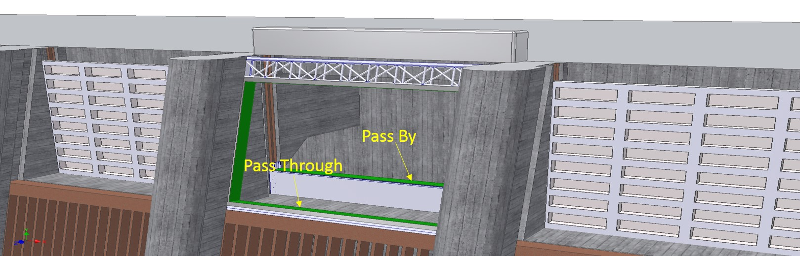
Control Bay with Redundant Pass Through Antenna.
Antenna inserted into trash rack guides.
Due to the physical size of this antenna, a Biomark Inc. FS-3001 transceiver would be required to generate an adequate detection field.
Notes:
.

Slide 5
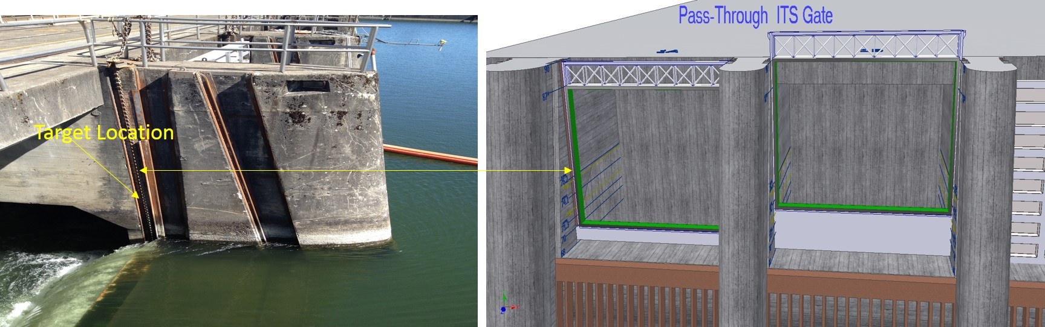
Chain Gate Antenna Scheme. Bays 1A and 1B.
Due to changing forebay levels and being a non-controlled bay, these two detection areas would require a pass through antenna due to the limited detection range of the flat plate antennas.
To optimize detection efficiency, antenna height could be reduced with the addition of a debris deflector, if acceptable to site O&M.

Slide 6
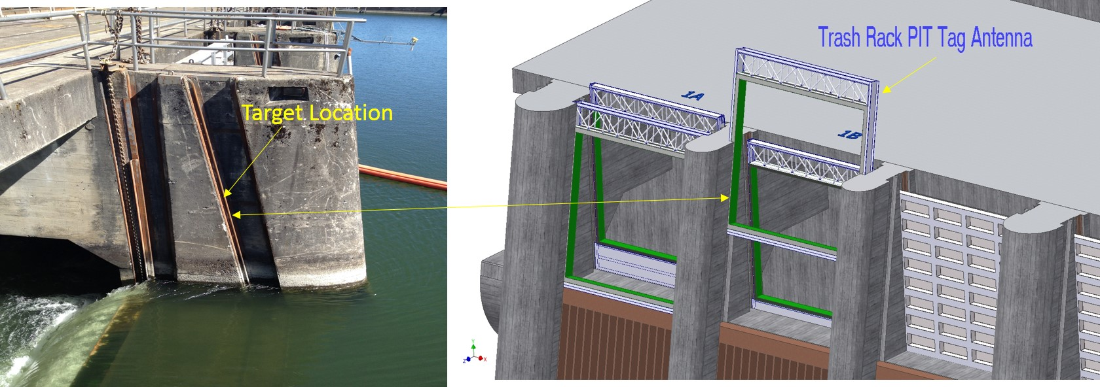
Redundant Chain Gate Antenna Scheme. Bays 1A and 1B.
An additional pass through antenna could be added utilizing the trash rack guides.

Slide 7
General Comments
The NOAA flexible antenna design was discussed with NOAA Sandpoint engineering, who stated that this design would not be suitable for this location.
The one antenna per bay scheme would provide good detection rates. With the addition of redundant antennas within the same bay, the detection rates would increase even more. E.g., one antenna goes down, the other is still operating.
The redundant scheme will also decrease the effects of tag collisions or poor tag orientation.
The information gained by this installation could be used at other locations such as The Dalles.

Slide 8
General Comments continued
It is our understanding that a spare gate may be available. This spare could be used as a prototype for testing both flat plate and pass through designs.
The design, installation and infrastructure of this system would require a team of engineers including structural, mechanical, hydraulic and electrical.
PSMFC would be responsible for the design and prototyping of the antennas.
Initial prototyping of the flat plate antennas has already taken place with promising results.

Slide 9
Questions or Comments?
Don Warf 509.735.2773 Ext. 1 dlwarf@psmfc.org
Scott Livingston 509.735.2773 Ext. 2 scottl@psmfc.org
Alan Brower 509.735.2773 Ext. 4 abrower@psmfc.org

